Slide 1
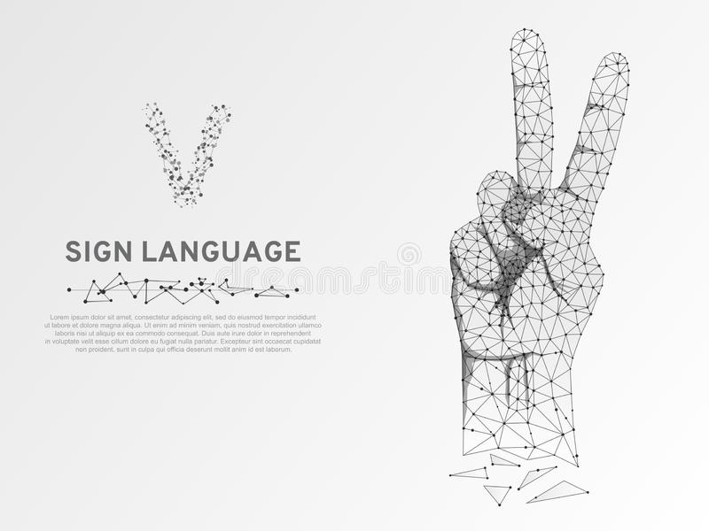


“Real time” Hand Gesture Recognition and Live Hand Sign Translator
By:
Sasi Vatsal - 20l31a5413
Thrushith - 20l31a5461
Jagan - 20l31a5449
Shaieen - 21l31a5405
Vivek Dattu - 20l31a5446

Slide 2

Abstract :
It is a very difficult world when we are unable to interact with our fellow mates. Imagine the world for deaf and mute, they face more challenges in communicating than we do, they surely can use sign languages but how many of us are thorough with the sign languages. Hence, we recognized this problem and thought of making the interaction easier. We are using a Leap Motion Controller for the gesture recognition for which we created a Machine Learning model that will detect the gesture and tell it further to the people who are not aware of the sign language, hence making it easier for interaction.

Slide 3
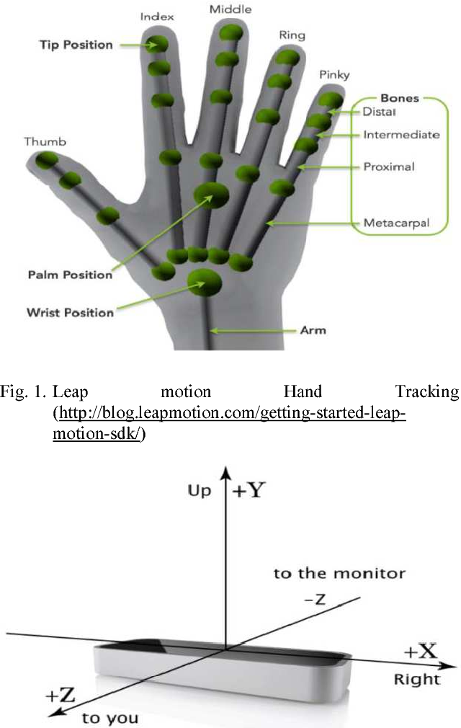
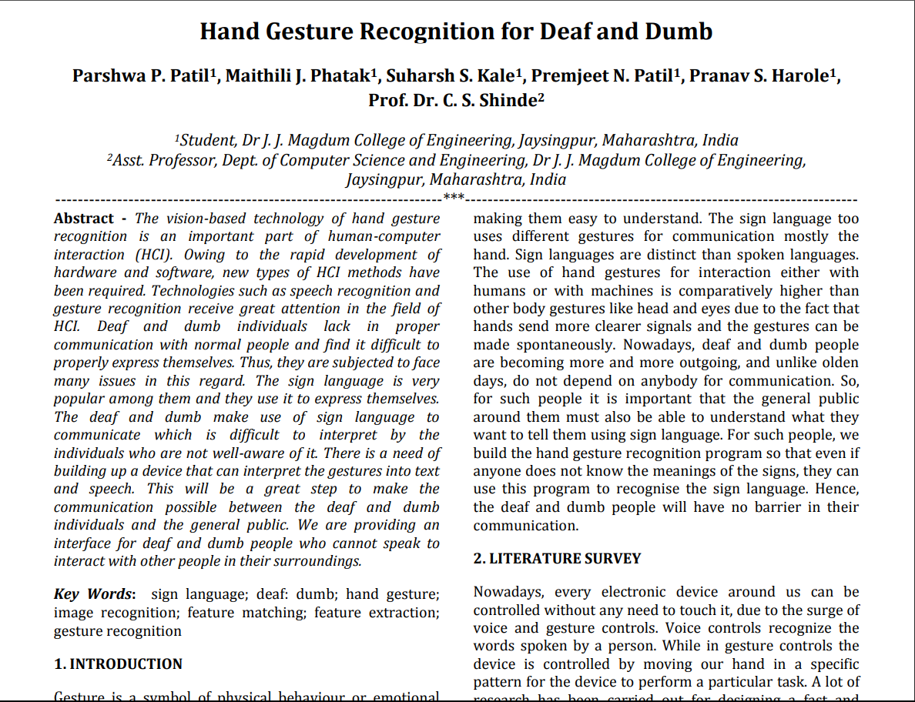
Previous model :
BY:
Parshwa P. Patil, Maithili J. Phatak, Suharsh S. Kale, Premjeet N. Patil, Pranav S. Harole, Prof. Dr. C. S. Shinde
The link for the base paper is provided here:👇👇
https://www.irjet.net/archives/V6/i11/IRJET-V6I11170.pdf

Slide 4
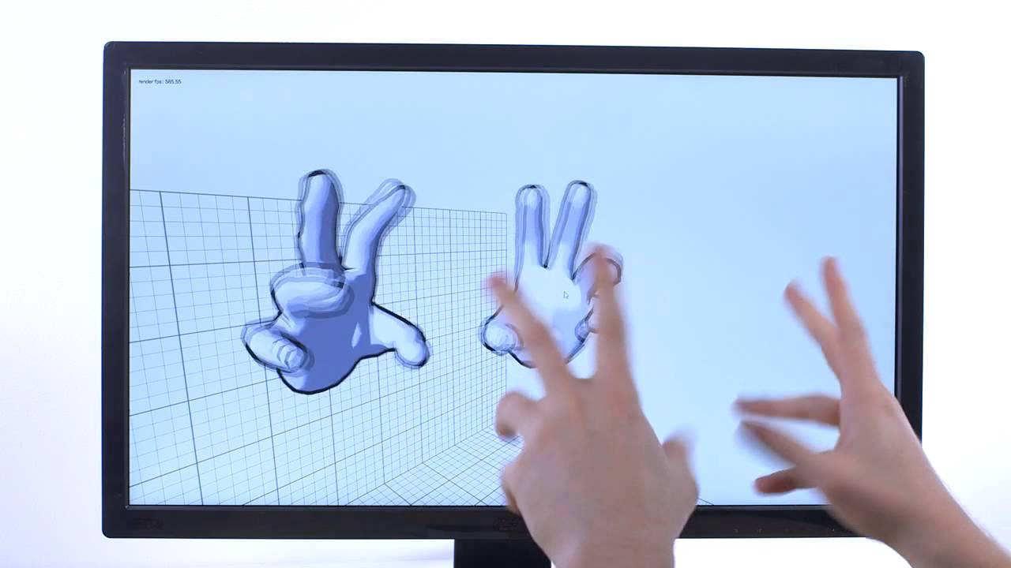
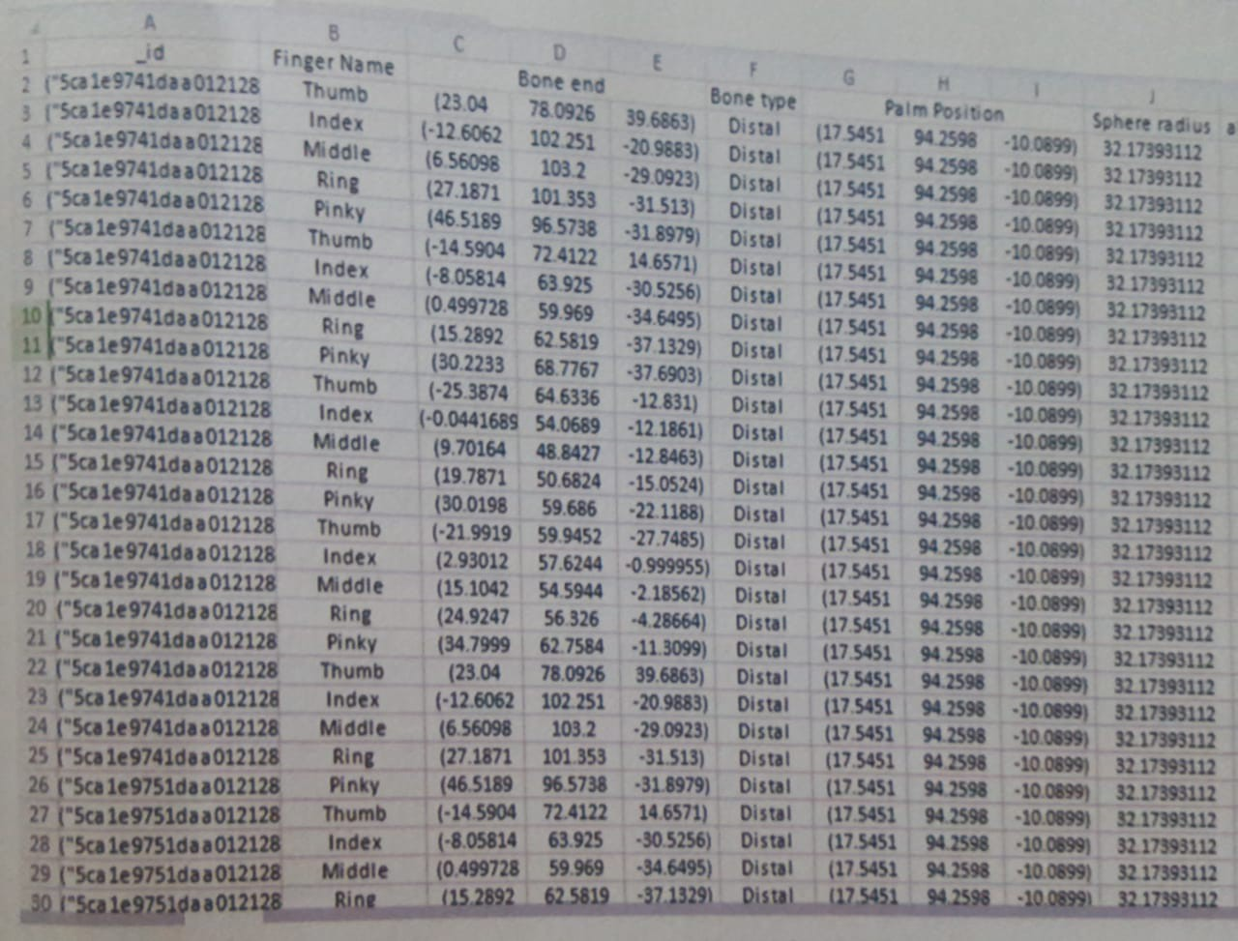
Advantages :
It is very easy to implement once the data set is provided because the model can also be extended into various platforms.
This model is easily portable i.e, it can be used in many cross platforms.
The real time FEED is also shown in this model.
The accuracy is more when compared to the prior models.
“ACCURACY = 94.0643 %”

Slide 5
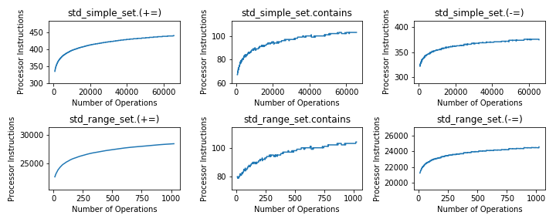
Disadvantage :
The previous models have no portability feature i.e., there is no proper application.
There is no real time conversion in the previous models.
The prior models have less accuracy when compared to the present model.

Slide 6
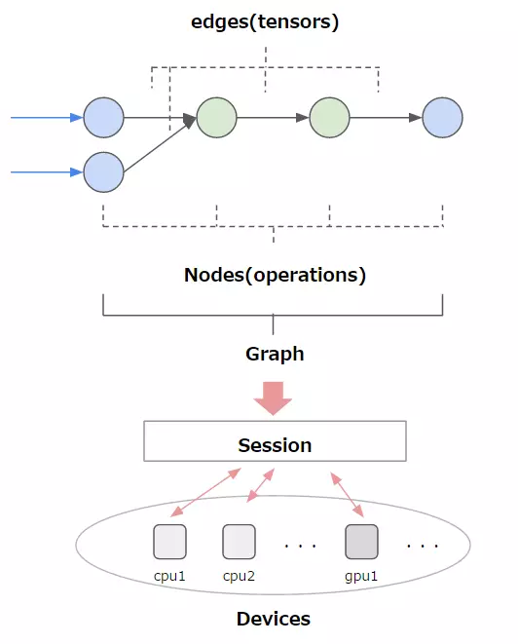
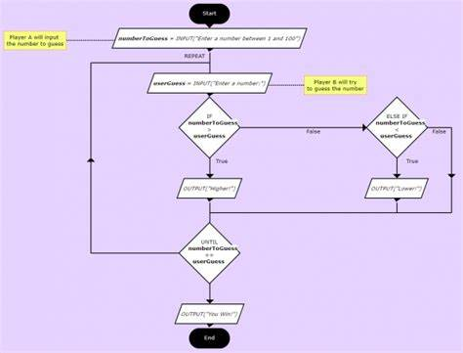
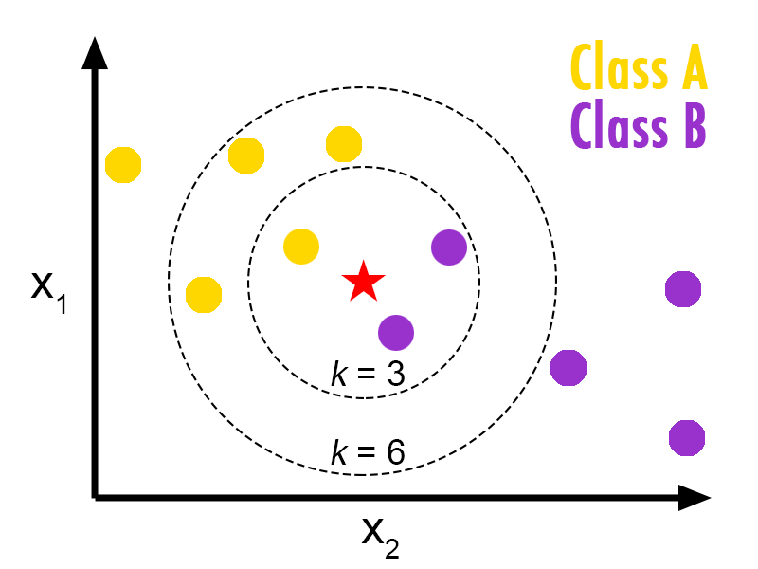
Requirements :
Webapp : Streamlit
Development : Heroku
Python libraries :
Tensorflow
Keras
Pandas
Numpy
Sklearn
LMC
Computer vision, Mediapipe
Circle gestures
Key tap gestures
Swipe gesture
Algoritms :
KNN
Random Forest
Decision Tree

Slide 7


